Slide 1
Week 4 Proof of concept
DESN2000 Workshop
Design Next, workshop 4

Slide 2
Today – Making a feasibility study and the proof of concept
Introduction → why start early in making a feasibility reflection and plan in advance your user testing. Also for this workshop we use MIRO’s tools
Map out project context → consider the field of application of your project stream to better adapt tools and methods
Plan your feasibility study and your user testing→ who do what how where and when
Intro | Activity 1 | Activity 2 | Wrap-up
10 min | 40 min | 40 min | 10 min
all | teamwork | teamwork | all

Slide 3
Overview - Aims
When you have a solution (in different stages of development), you can start early to verify the feasibility and to test the viability. Validate your concept by answering to these questions:
Is my solution feasible?
Is my solution answering to the needs I collected from the user research? Why?
How can I proof my concept is the best answer to the problem?
Which components present more value for the users and stakeholders?
Which components present more risks for the feasibility?
Can I replace something in my solution to reduce waste?
When and Where can I test my solution?

Slide 4
Overview – where we are
Affinity maps / personas Unique value proposition
Site visits Interviews Desk research Observation Immersion Prototypes
Morphological matrix
Brainwriting
Crazy 8’s
Collaborative sketching
Mindmaping
Scamper
Numerical Voting Empirical Critique Proof of concept
User testing
Problem
Solution
Technical design
Research
Define
Ideate
Evaluate

Slide 5
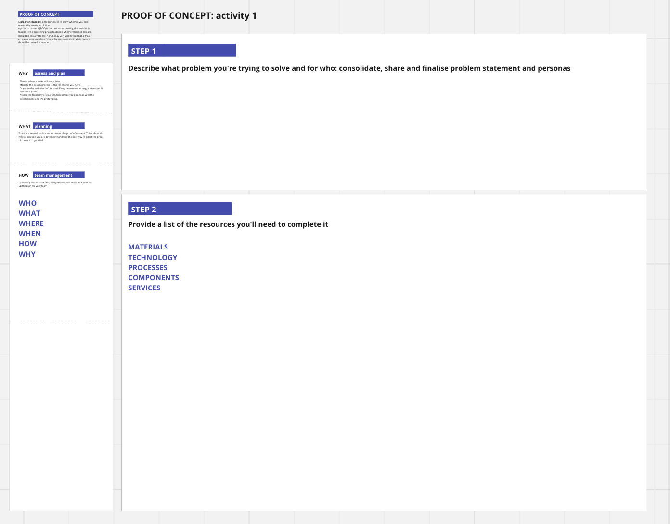
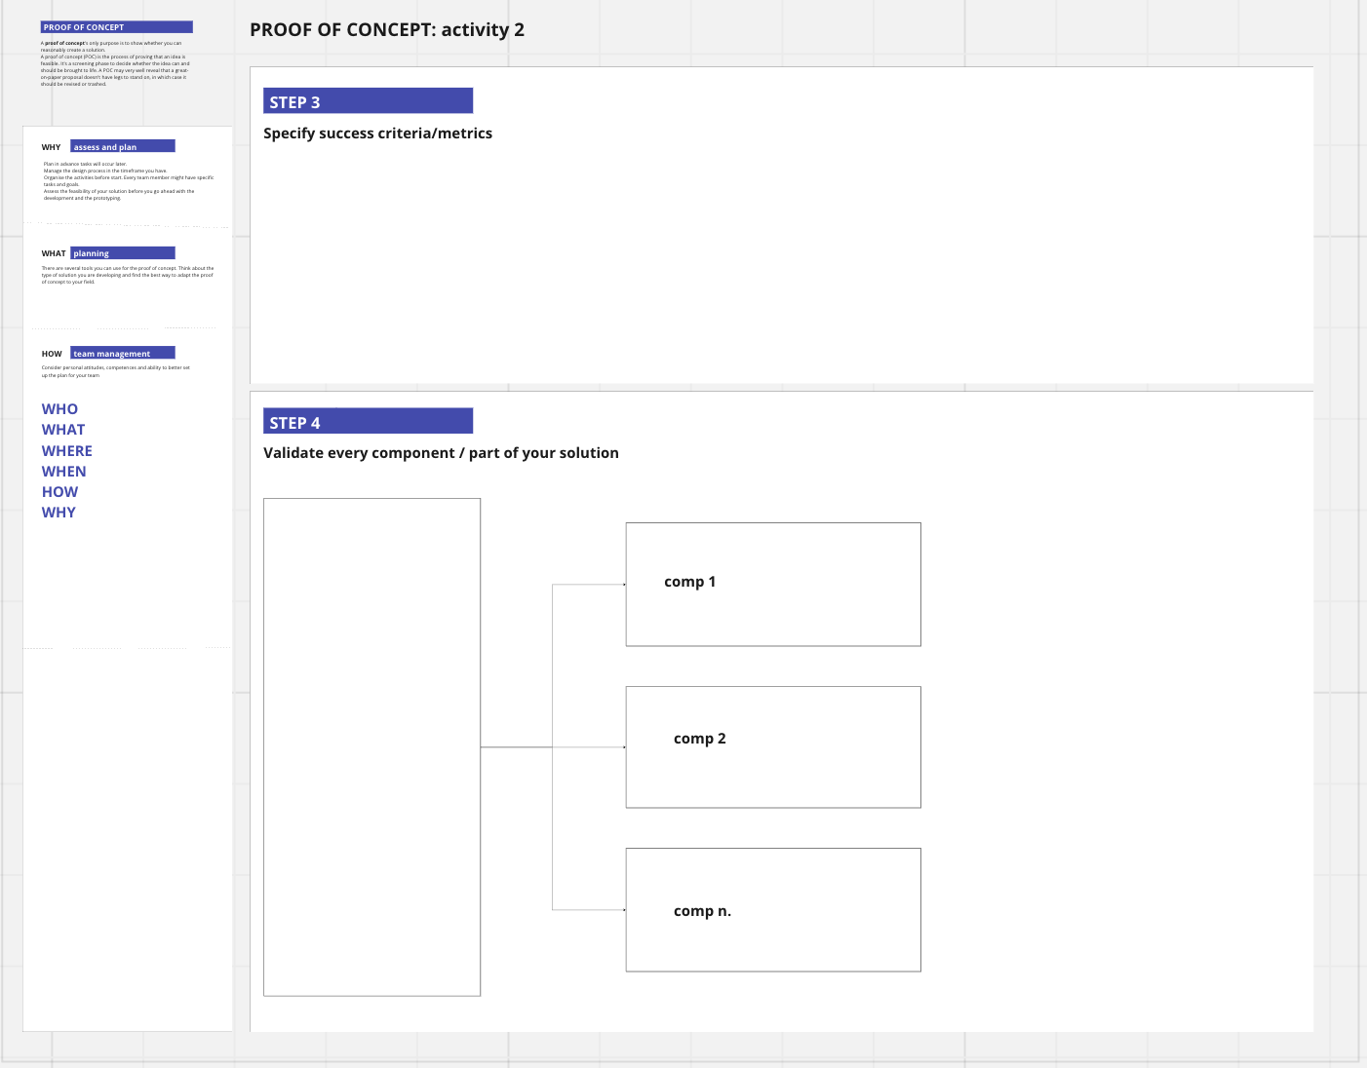
Overview - Method
2 steps 2 tools
Consolidate the concept and define resources
Criteria and validation

Slide 6
Consolidate the concept and define resources
40 minutes
Consider opportunities or limits that can influence the development of your project
Consider the problem and the needs emerged in your research and list why your solution is solving them
Consider your solution and define which resources you need:
Materials
Components
Processes
Technologies
Services
Intro | Activity 1 | Activity 2 | Wrap-up
10 min | 40 min | 40 min | 10 min
all | teamwork | teamwork | all

Slide 7

You can stick post-it, pictures or use other Miro’s tool

Slide 8
Success criteria and validation
40 minutes
Now you know why your solution solve a problem for some specific users and stakeholders and you know which resources you need. Try to validate your concept (proof of concept) by defining:
- success criteria and metrics to assess your concept (try to connect your metrics and criteria with needs of your users)
- with these metrics validate every component / part of your solution
Intro | Activity 1 | Activity 2 | Wrap-up
10 min | 40 min | 40 min | 10 min
all | teamwork | teamwork | all

Slide 9
You can stick post-it, pictures or use other Miro’s tool

Slide 10
Wrap-up
5 minutes
Brief reflection
How did the group go?
What will you work towards?
A few tips :
Remember it is a qualitative approach
Proof of concept supports the building of evidence (and the storytelling)
During proof of concept your solution might change!
Always consider the user perspective!
Intro | Activity 1 | Activity 2 | Wrap-up
10 min | 40 min | 40 min | 10 min
all | teamwork | teamwork | all

